Slide 1
Reaching stop
Instructions
Jump-Stop versus Jump-Change
Ricci
April 21

Slide 2
Overview
The task involves moving the mouse cursor to different targets on the screen.
There are different phases of the experiment
The typical duration for completing each part is described below:
Phase | Name | Duration (mins)
1 | Practice pt. 1 | 5
2 | Practice pt. 2 | 5
3 | Main experiment pt. 1 | 20
4 | Practice pt. 3 | 5
5 | Main experiment pt. 2 | 20
The first phase also examines whether your set-up and your performance levels are appropriate for the experiment.
If they are not, you can either: (1) return the submission and email me the code show to receive compensation up to that point; or (2) continue and risk rejection.

Slide 4
Please ensure:
You are sat comfortably at a table or desk
The computer monitor is approximately 60 cm (24 in) or arms length from you
~60 cm or arms length
Eye-level

Slide 5
Please ensure you have:
An external mouse connected
Space on the table about the size of an A4 sheet of paper to move the mouse (approx. 30 x 24 cm or 12 x 9 in)
Monitor
24 cm / 9 in
30 cm / 12 in

Slide 6
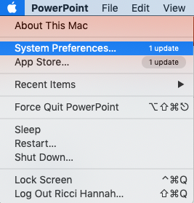
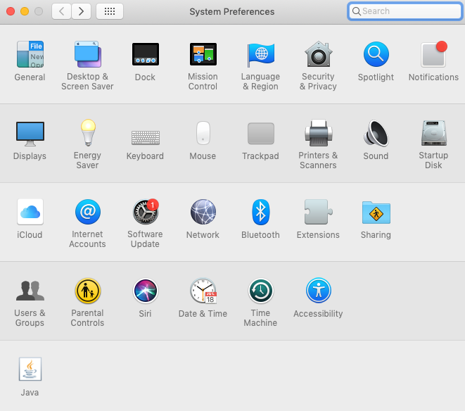
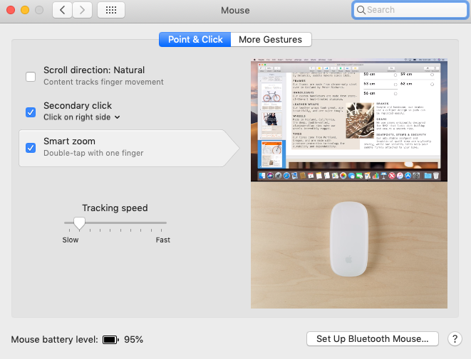

Please adjust your mouse settings as follows:
If you are an Apple user
Go to the Apple icon in the top left corner of the screen
Click on ‘System Preferences’
Click on the ‘Mouse’ icon
Adjust tracking speed so that it is one notch above the slowest speed

Slide 7
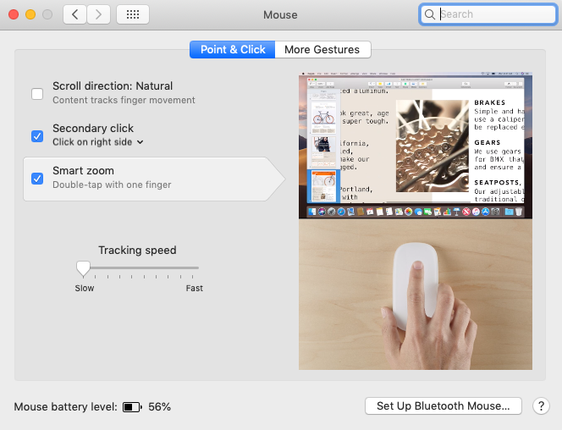
Please adjust your mouse settings as follows:
NOTE - You should be using a Mac
Go to the Apple icon in the top left corner of the screen
Click on ‘System Preferences’
Click on the ‘Mouse’ icon
Adjust tracking speed so that it is at its slowest

Slide 9
home
Reaction time task – Practice
Every trial starts with the following screen.
You should move the mouse cursor over the home pad and left click to begin the trial.
Click on home pad to begin
Home

Slide 10
home
Reaction time task – Practice
Shortly afterwards, a green target will appear.

Slide 11
home
Reaction time task – Practice
Your task is to respond by moving the cursor to the green target.
Try to be quick and reach the target in a single, smooth movement.
Try to be both accurate and fast.

Slide 12
home
Reaction time task – Practice
Leaving the home pad before the target has appeared will result in a message telling you that you “Moved Too Soon”.

Slide 13
Reaction time task – Practice
Each trial begins with the same request to click on the home pad
Try your best to move the mouse and your arm back to the same central starting position each time.
Monitor
Click on home pad to begin
Home

Slide 15
home
Jump-Stop task – Practice
Every trial starts the same as before.
You should move the mouse cursor over the home pad and left click to begin the trial.
Click on home pad to begin
Home

Slide 16
home
Jump-Stop task – Practice
Shortly afterwards, a green target will appear.

Slide 17
home
Jump-Stop task – Practice
Your task is to respond by moving the cursor to the green target.
Try to be quick and reach the target in a single, smooth movement.
Try to be both accurate and fast.

Slide 18
home
Jump-Stop task – Practice
HOWEVER
On some trials, the target will jump to the right (shown here) or left shortly after it first appears.

Slide 19
Jump-Stop task – Practice
If the target jumps to the left or right, you must try your best to stop moving and avoid hitting both the old and new position of the target
Sometimes you will…
Correctly stop before you hit the target.
Fail to stop, so that you hit the old target position.
This is OK.
Please just try your best to stop whenever the target jumps to a new position.

Slide 21
home
IMPORTANT
You are about to perform a new task.
The rules of the task are different to the previous one.
Please pay close attention to the following instructions.

Slide 23
home
Jump-Change task – Practice
Every trial starts the same as before.
You should move the mouse cursor over the home pad and left click to begin the trial.
Click on home pad to begin
Home

Slide 24
home
Jump-Change task – Practice
Shortly afterwards, a green target will appear.

Slide 25
home
Jump-Change task – Practice
Your task is to respond by moving the cursor to the green target.
Try to be quick and reach the target in a single, smooth movement.
Try to be both accurate and fast.

Slide 26
home
Jump-Change task – Practice
HOWEVER
On some trials, the target will jump to the right (shown here) or left shortly after it first appears.

Slide 27
Jump-Change task – Practice
If the target jumps to the left or right, you must try your best to re-aim and hit the target in its new position and avoid hitting the old position.
Sometimes you will…
Correctly re-aim and hit the new target.
Incorrectly hit the old target before hitting the new target.
This is OK.
Please just try your best to hit the new target position as quickly and accurately as you can.

