Slide 1
Reaching stop
Instructions
Planned vs Ongoing Stop - Replication
Ricci
June 21

Slide 2
Overview
The task involves moving the mouse cursor to different targets on the screen.
There are three phases of the experiment
The typical duration for completing each part is described below:
Phase | Name | Duration (mins)
1 | Practice pt. 1 | 5
2 | Practice pt. 2 | 5
3 | Main experiment | 45
The first phase also examines whether your set-up and your performance levels are appropriate for the experiment.
If they are not, you can either: (1) return the submission and message me the code shown at that stage to receive compensation up to that point; or (2) continue and risk rejection.

Slide 4
Please ensure:
You are sat comfortably at a table or desk
The computer monitor is approximately 60 cm (24 in) or arms length from you
~60 cm or arms length
Eye-level

Slide 5
Please ensure you have:
An external mouse connected
Space on the table about the size of an A4 sheet of paper to move the mouse (approx. 30 x 24 cm or 12 x 9 in)
Monitor
24 cm / 9 in
30 cm / 12 in

Slide 6
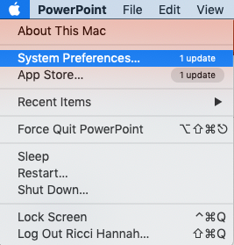
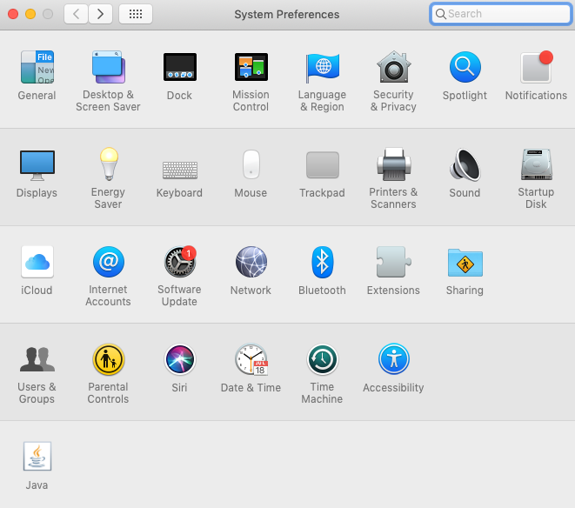
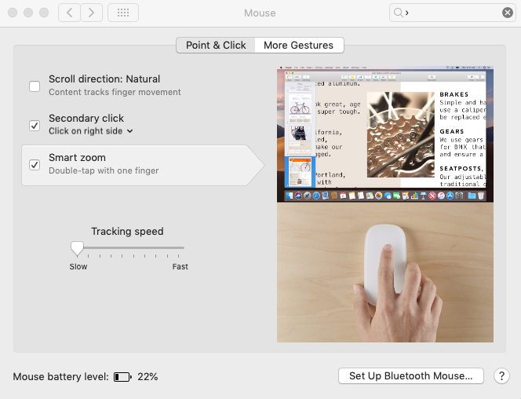
Please adjust your mouse settings as follows:
If you are a Mac user
Go to the Apple icon in the top left corner of the screen
Click on ‘System Preferences’
Click on the ‘Mouse’ icon
Adjust tracking speed so that it is at the slowest speed

Slide 7
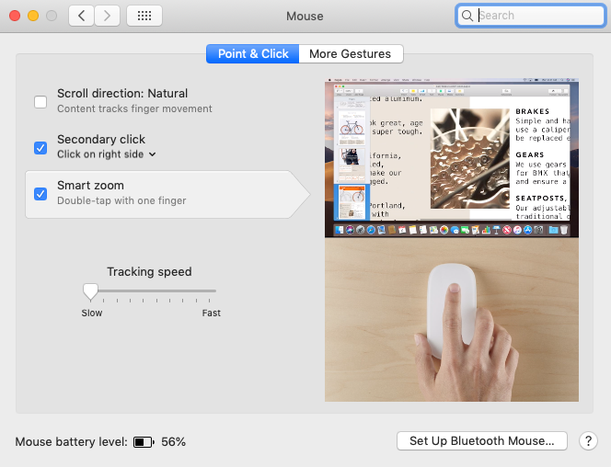
Please adjust your mouse settings as follows:
NOTE - You should be using a Mac
Go to the Apple icon in the top left corner of the screen
Click on ‘System Preferences’
Click on the ‘Mouse’ icon
Adjust tracking speed so that it is at its slowest

Slide 8
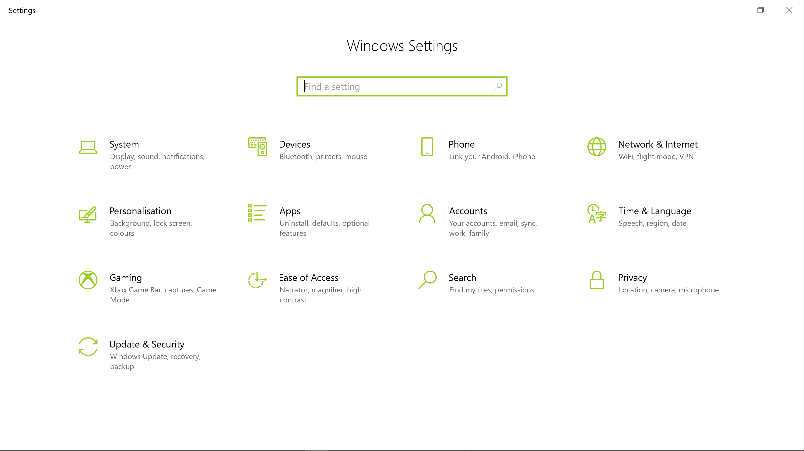
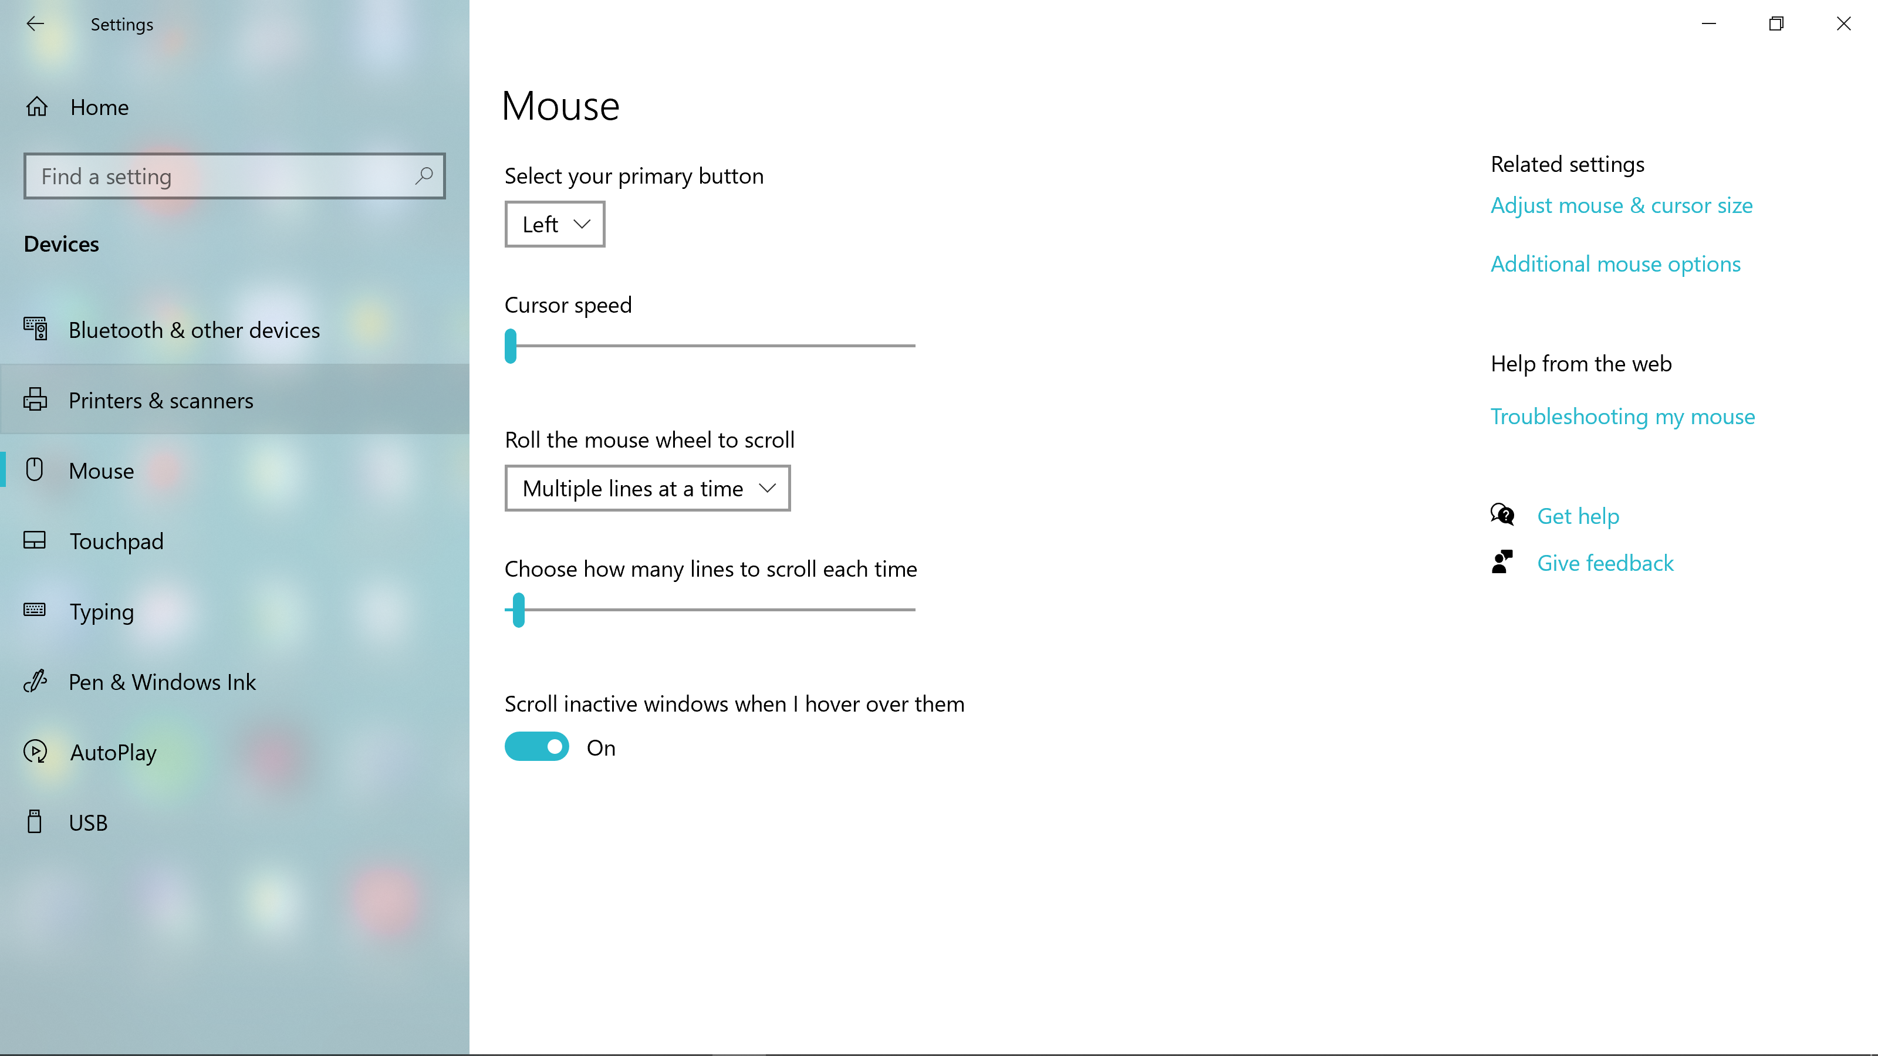
Please adjust your mouse settings as follows:
If you are a Windows user
Click on ‘Start’ button in bottom left to open menu
Then click ‘Settings’
Click ‘Devices’
Click ‘Mouse’
Adjust cursor speed so that it is at its slowest

Slide 10
home
Reaction time task – Practice
Every trial starts with the following screen.
You should move the mouse cursor over the home pad and left click to begin the trial.
Click on home pad to begin
Home

Slide 11
home
Reaction time task – Practice
Doing so begins the trial and causes text to disappear and two targets to appear.

Slide 12
home
Reaction time task – Practice
Shortly afterwards, an arrow will appear between the two targets.
The direction of the arrow indicates which target to aim for:
< is left and > is right
>

Slide 13
home
Reaction time task – Practice
Shortly afterwards, a letter will appear between the two targets.
The letter indicates which target to aim for:
‘T’ is left and ‘X’ is right
X

Slide 14
home
Reaction time task – Practice
Your task is to respond by moving the cursor to the target pointed to by the arrow.
Try to reach the target in a single, smooth movement.
Try to be both accurate and fast.
>

Slide 15
home
Reaction time task – Practice
Your task is to respond by moving the cursor to the target indicated by the letter.
Try to reach the target in a single, smooth movement.
Try to be both accurate and fast.
X

Slide 16
home
Reaction time task – Practice
Leaving the home pad before the target has appeared will result in a message telling you that you “Moved Too Soon”.

Slide 17
Reaction time task – Practice
Reaction time task – Practice
Each trial begins with the same request to click on the home pad
Try your best to move the mouse and your arm back to the same central starting position each time.
Each trial begins with the same request to click on the home pad
Try your best to move the mouse and your arm back to the same central starting position each time.
Monitor
Monitor
Click on home pad to begin
Click on home pad to begin
Home
Home

Slide 19
home
Stop Signal Task – Practice
Every trial starts the same as before.
You should move the mouse cursor over the home pad and left click to begin the trial.
Click on home pad to begin
Home

Slide 20
home
Stop Signal Task – Practice
Doing so begins the trial and causes text to disappear and two targets to appear.

Slide 21
home
Stop Signal Task – Practice
Shortly afterwards, an arrow will appear between the two targets.
The direction of the arrow indicates which target to aim for:
< is left and > is right
>

Slide 22
home
Stop Signal Task – Practice
Shortly afterwards, a letter will appear between the two targets.
The letter indicates which target to aim for:
‘T’ is left and ‘X’ is right
X

Slide 23
home
Stop Signal Task – Practice
Your task is to respond by moving the cursor to the target pointed to by the arrow.
Try to reach the target in a single, smooth movement.
Try to be both accurate and fast.
>

Slide 24
home
Stop Signal Task – Practice
Your task is to respond by moving the cursor to the target indicated by the letter.
Try to reach the target in a single, smooth movement.
Try to be both accurate and fast.
X

Slide 25
home
Stop Signal Task– Practice
HOWEVER
On some trials, another cue (red circle) will appear around the arrow.
>

Slide 26
home
Stop Signal Task– Practice
HOWEVER
On some trials, another cue (red circle) will appear around the letter.
X

Slide 27
Stop Signal Task – Practice
If the red circle appears, you must try your best to stop moving and avoid hitting any of the targets.
Sometimes you will…
Stop before you leave the home pad.
Start to move but stop before the target.
Fail to stop, i.e. hit the target.
>
>
>
Please try to stop as soon as you can whenever the red circle appears.

Slide 28
Stop Signal Task – Practice
If the red circle appears, you must try your best to stop moving and avoid hitting any of the targets.
Sometimes you will…
Stop before you leave the home pad.
Start to move but stop before the target.
Fail to stop, i.e. hit the target.
X
X
X
Please try to stop as soon as you can whenever the red circle appears.

